Slide 1


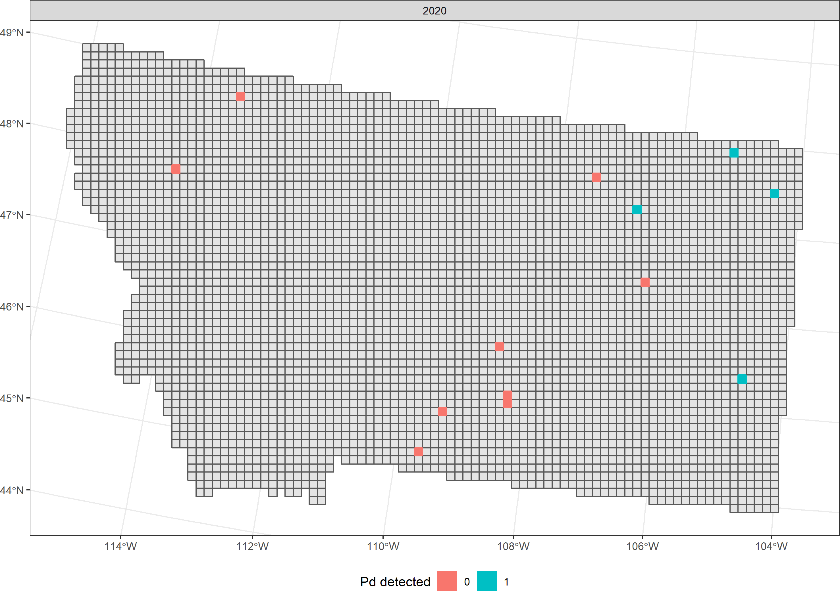
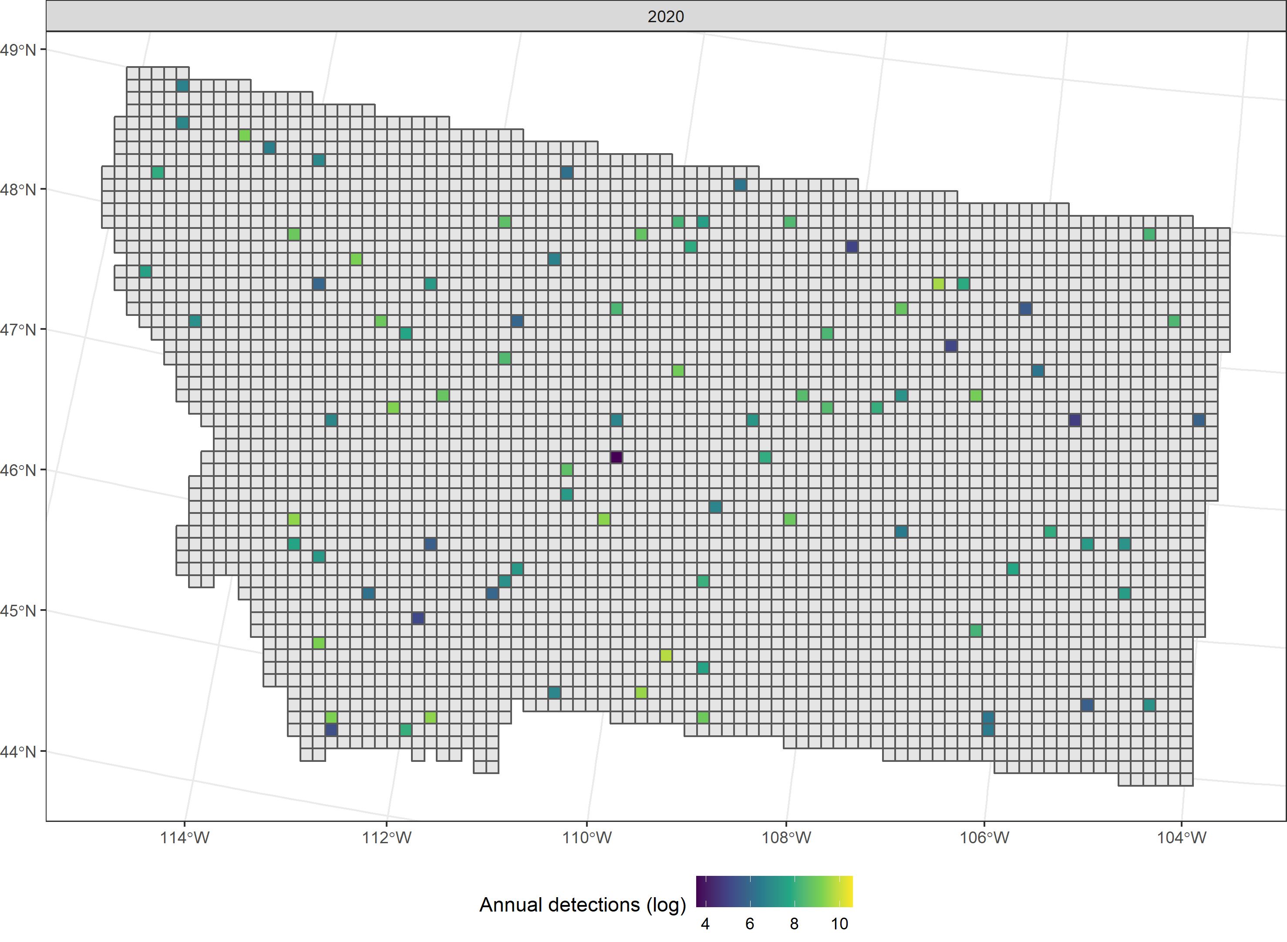
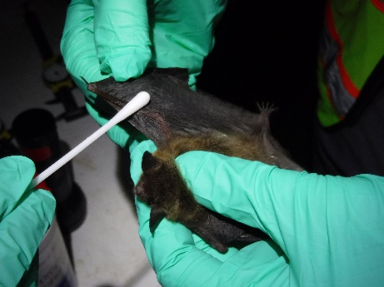
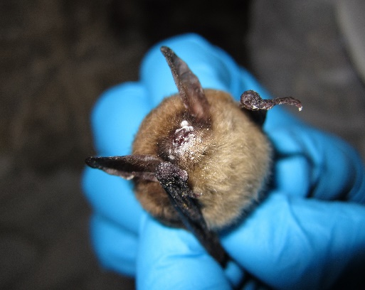
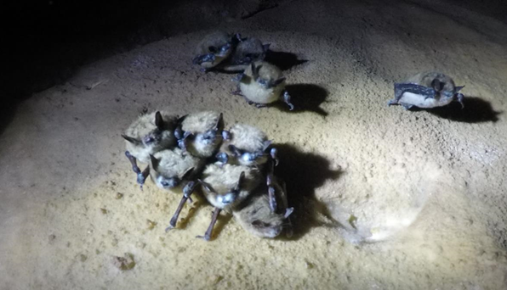
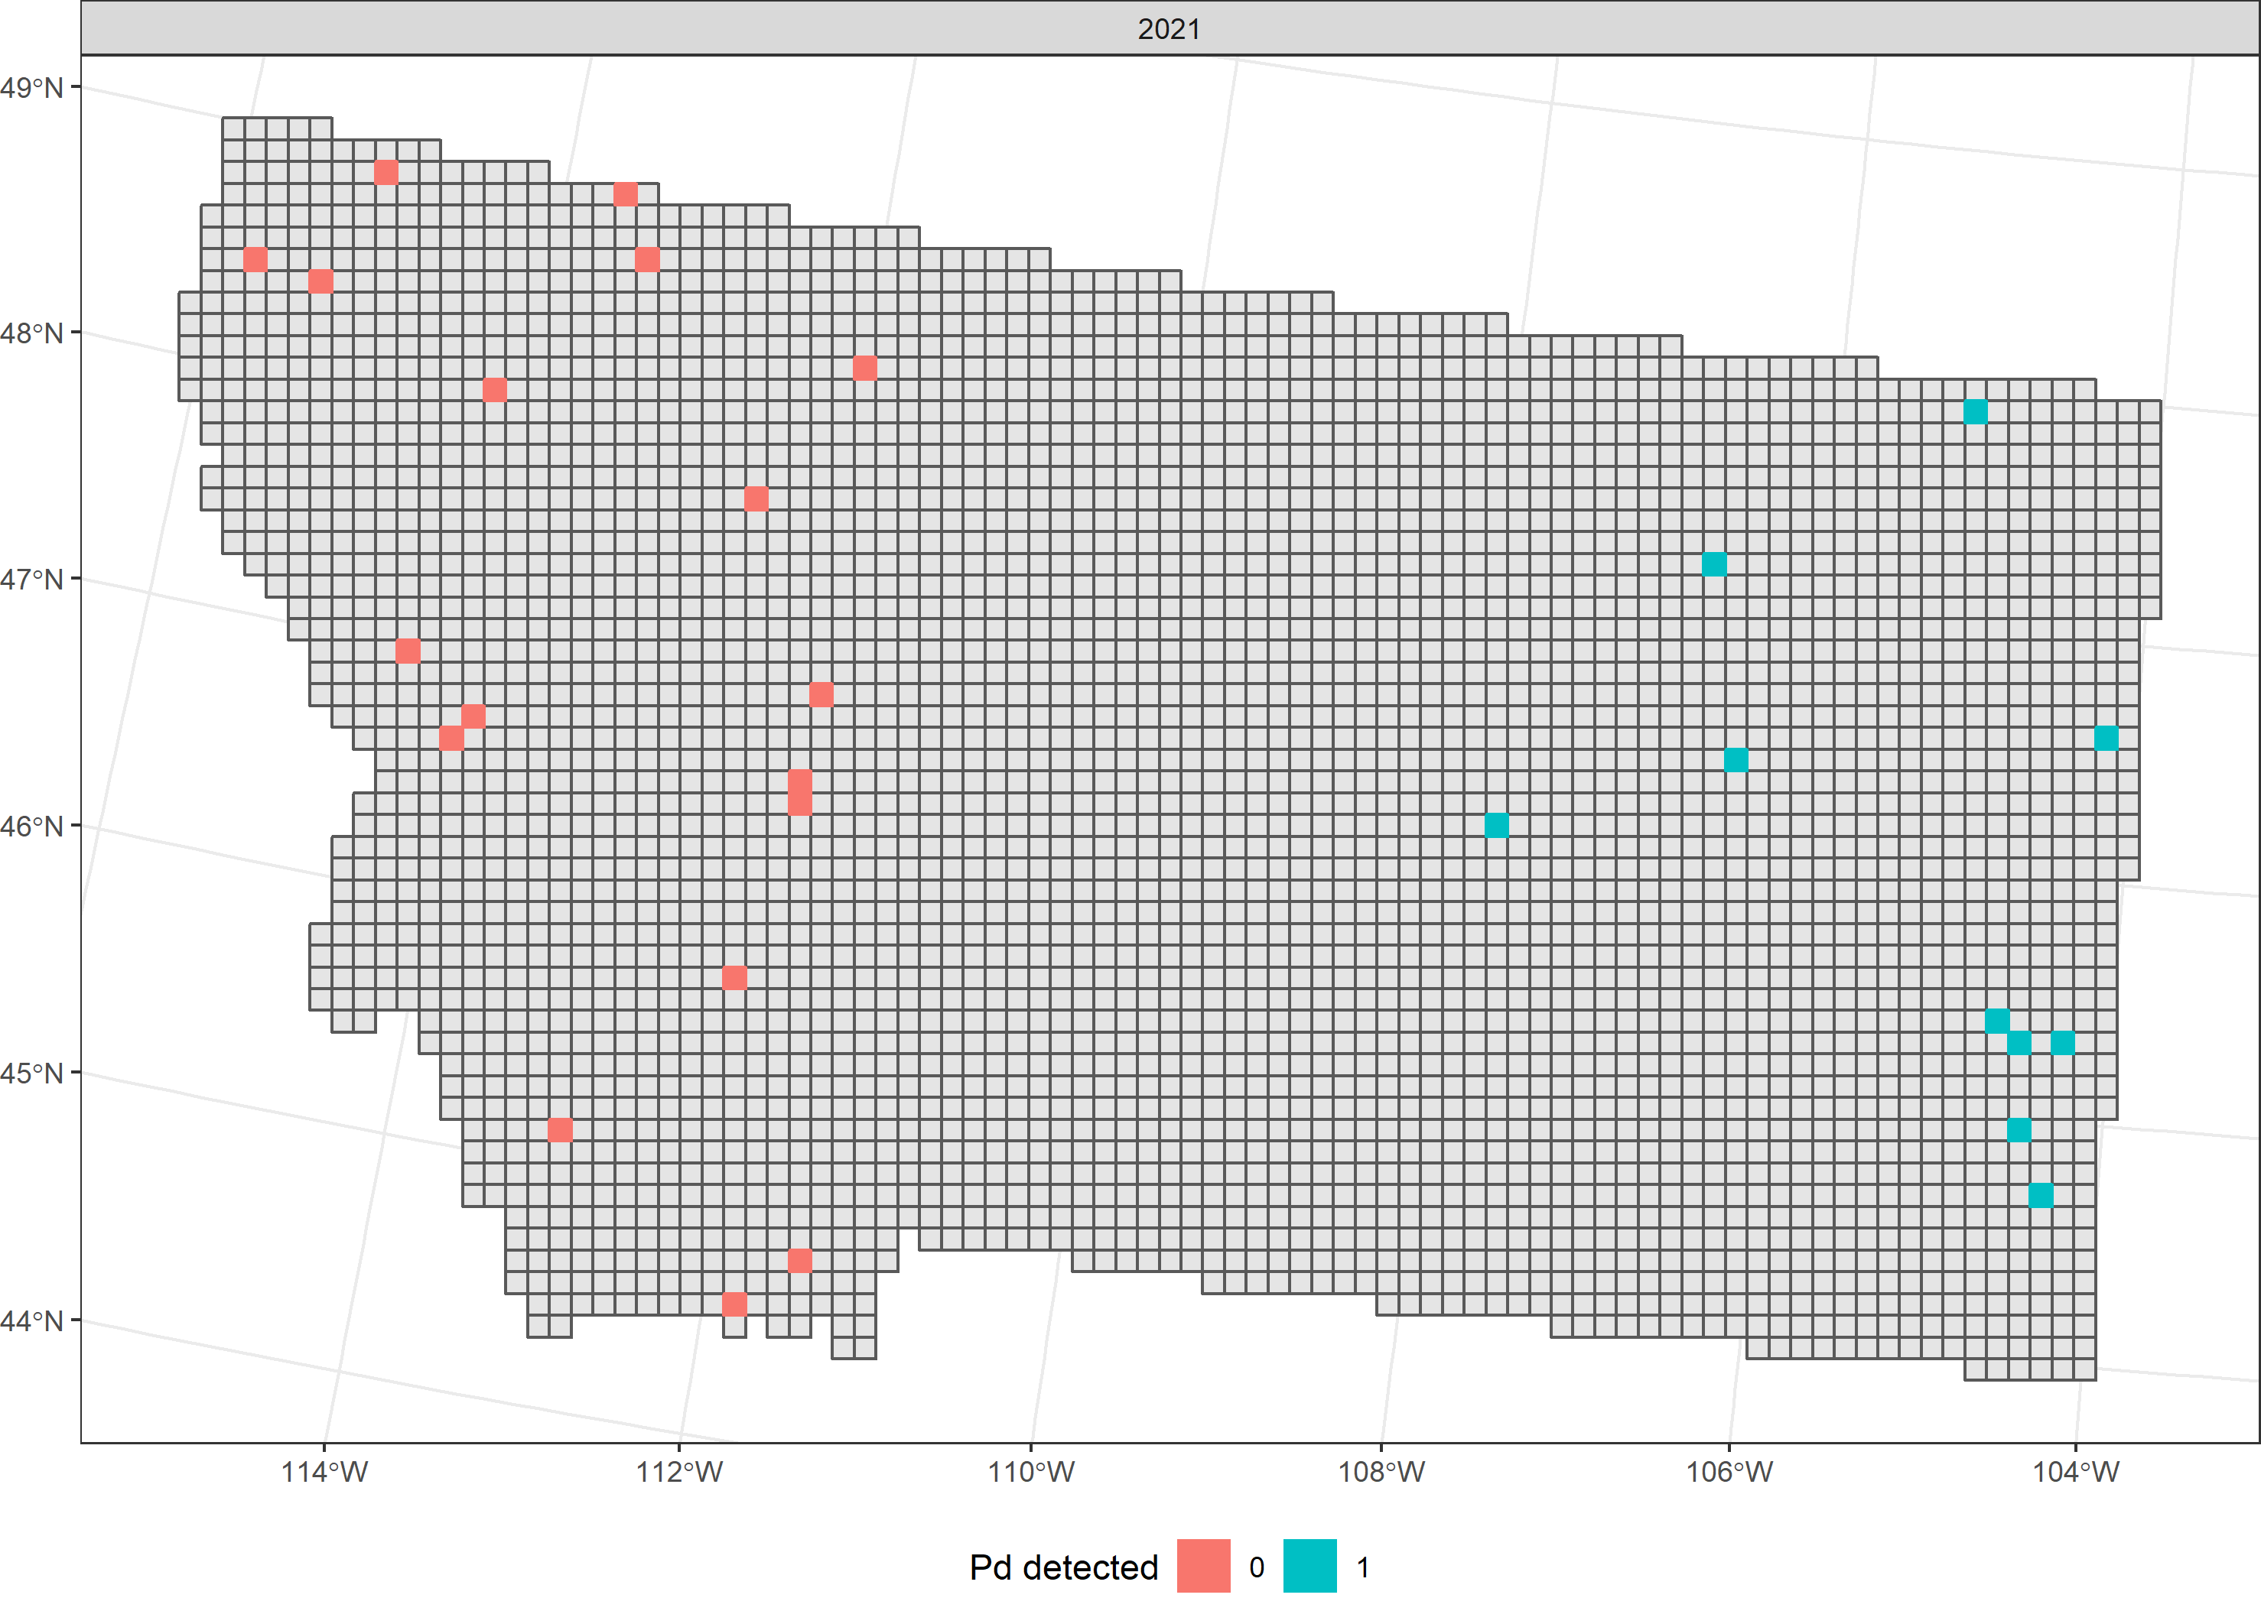
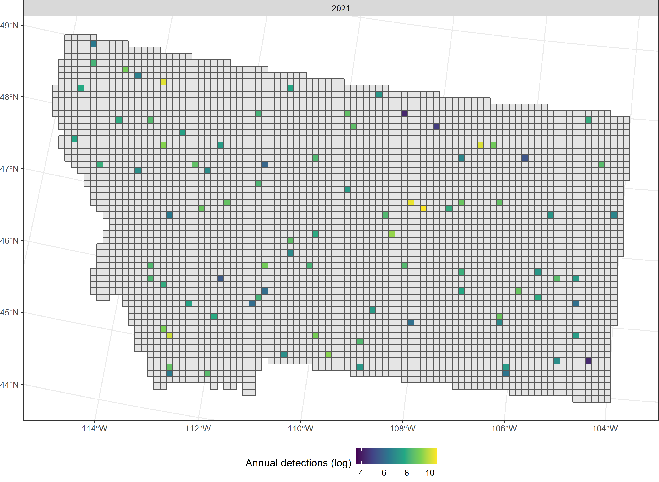
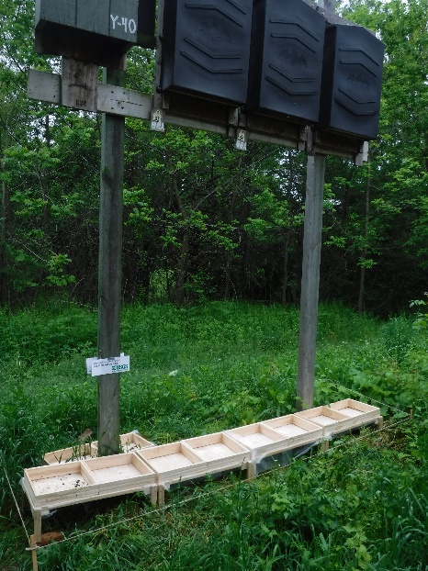
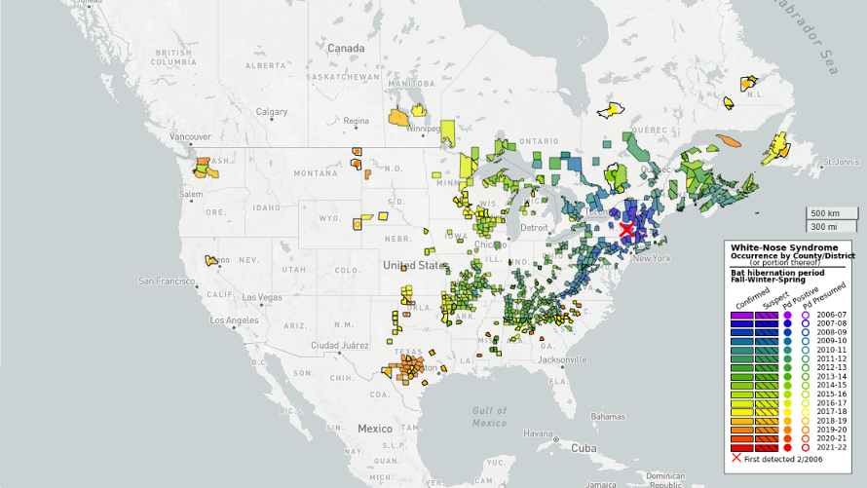
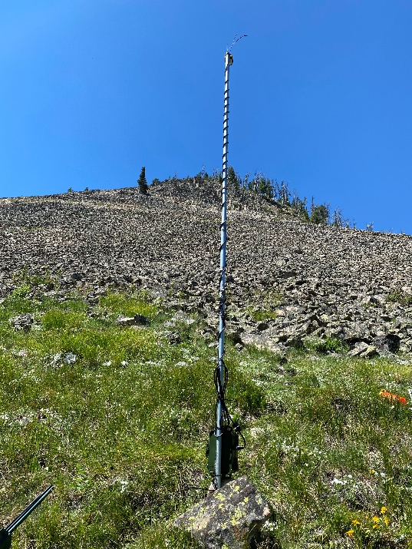
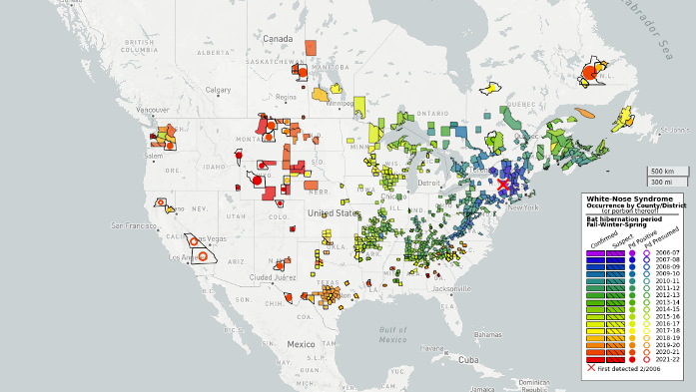
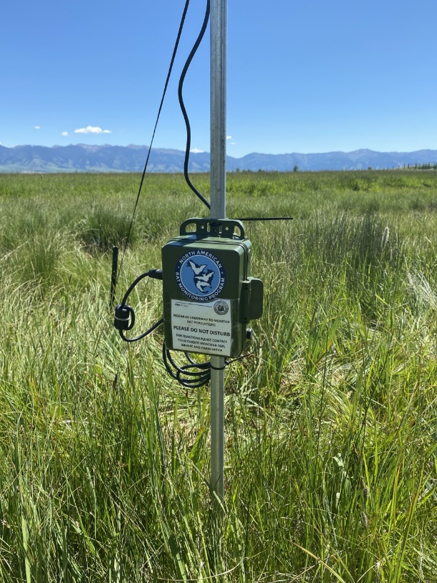
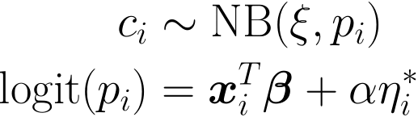
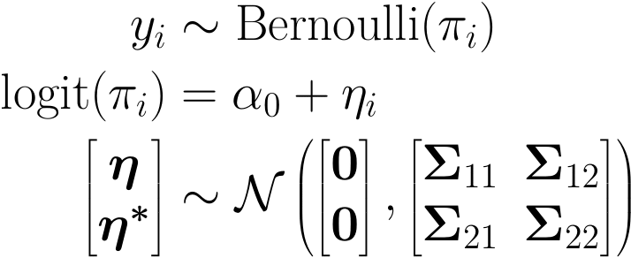

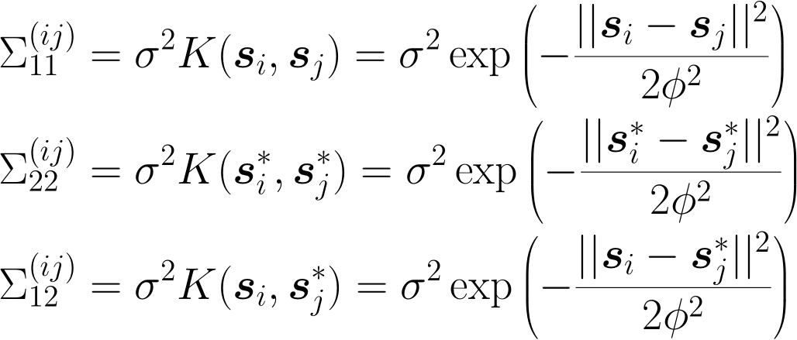
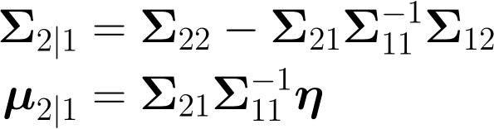
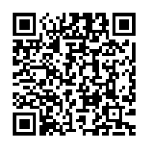
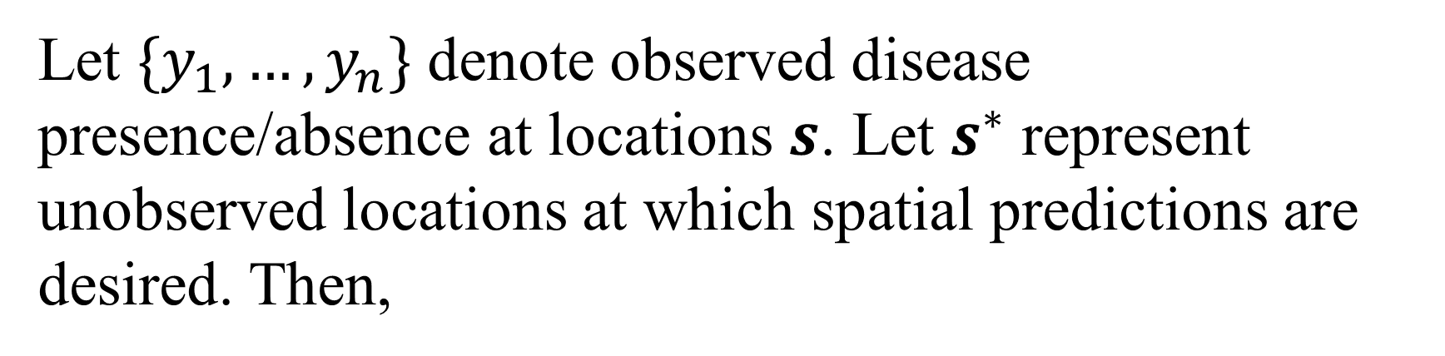
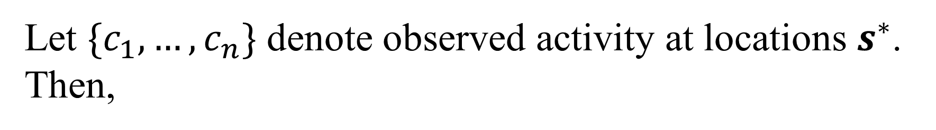
Joint spatial modeling of relative activity and disease processes
Christian Stratton, Kathryn Irvine, Emily Almberg, Kristina Smucker, Justin Gude
Motivation
Available Data
Data Collection
Figure x: Guano collection boxes (source: USGS National Wildlife Health Center)
Whitenose syndrome
WNS surveillance data
Stationary acoustic data
WNS surveillance data
Figure x: Bat swabbed for Pd (source: USGS National Wildlife Health Center)
Disease caused by fungus Pseudogymnoascus destructans (Pd)
Interrupts hibernation leading to starvation and dehydration
First detected in New York (2006)
Figure xa: Pd surveillance data in Montana from 2020. Blue squares denote presence of Pd, red squares denote absence.
Figure xa: Log count of annual detections at survey locations in 2020.
Figure 1: Northern long-eared bat with visible signs of WNS (source: USFWS Flickr)
Figure 2: WNS-affected little brown bats in Azure Cave, MT, USA (source: Montana Fish Wildlife and Parks
Figure xa: Pd surveillance data in Montana from 2021. Blue squares denote presence of Pd, red squares denote absence.
Figure xa: Log count of annual detections at survey locations in 2020.
Figure 3: Pd spread map as of 2020 (source: USGS WNS Spread Map).
WNS surveillance data
Model Specification
Disease process model
Relative activity model
Let $\{y_{1}, …, y_{n}\}$ denote observed disease presence/absence at locations $s$. Let $s^{∗}$ represent unobserved locations at which spatial predictions are desired. Then,
Let $\{c_{1}, …, c_{n}\}$ denote observed activity at locations $s^{∗}$. Then,
Figure 4: Pd spread map as of 2022 (source: USGS WNS Spread Map)
Note that by properties of multivariate normal random variables,
where,
where,
References
For a list of references and author affiliations, please scan the QR code to the right.
Azure cave photo
This information is preliminary and is subject to revision. It is being provided to meet the need for timely best science. The information is provided on the condition that neither the U.S. Geological Survey nor the U.S. Government shall be held liable for any damages resulting from the authorized or unauthorized use of the information.
For more details on how this model is estimated, scan the QR code at the bottom right of this poster.
Notes:
Selby’s < Print me here! ☺ Save as pdf / jpeg and power point

